Slide 1
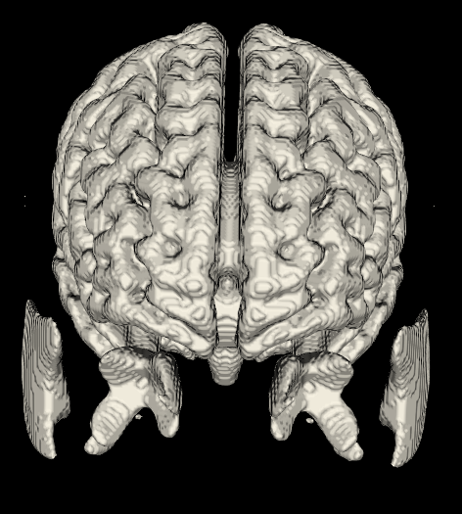
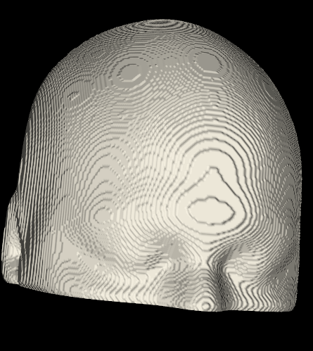
Face Rebuild
Visualization of MRI scans with VTK and ITK libraries
Sandro Scherrer, University of Bern, 17.12.2024

Slide 2
VTK and ITK
ITK used for image processing
Filtering
Resampling
Normalization
Thresholding
VTK used for visualization
Rendering
3D window and simple interaction
Marching cubes / Flying Edges Algorithm

Slide 3
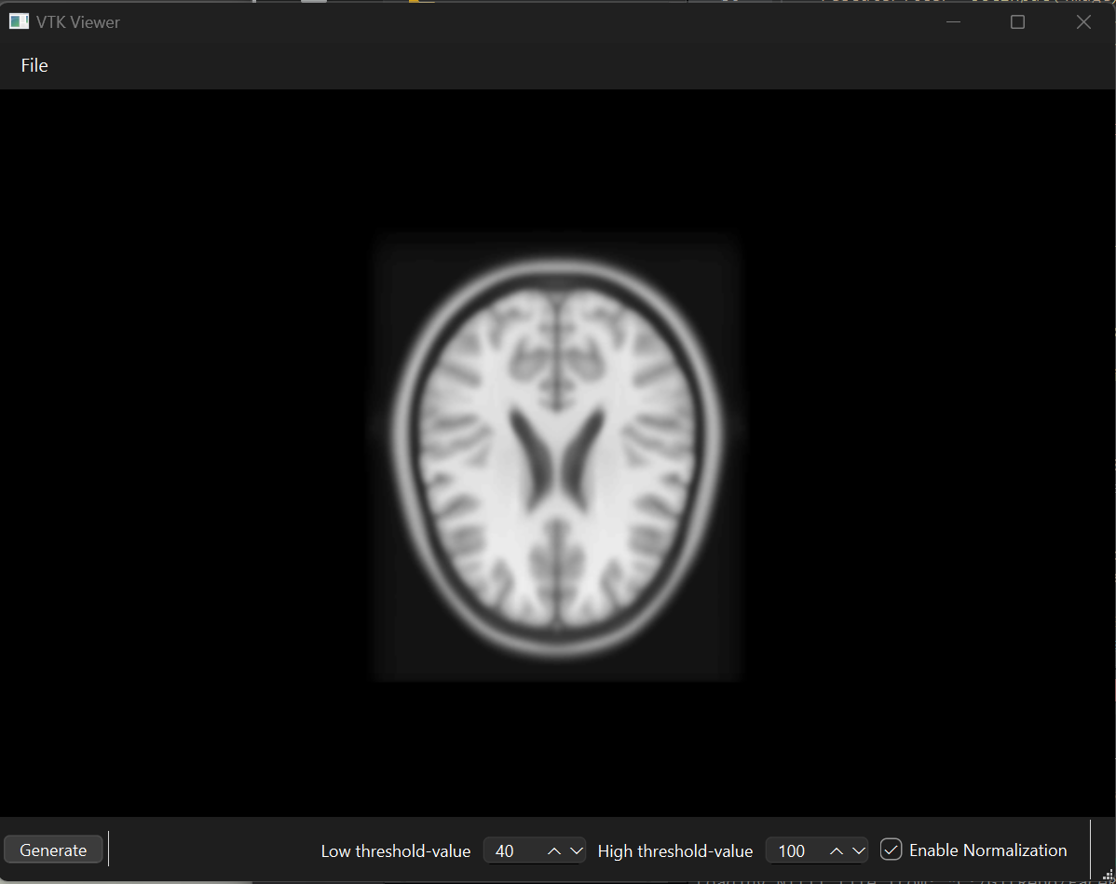
Demo
Notes:
Brain: 60-100
Face: 25-100

Slide 4
Pipeline to generate mesh
Filter, Normalize, Resample, Convert to VTK
Display NIFTI with VTK Slicer
Generate button: Filter, Threshold
Use Marching cubes or Flying Edges to get mesh
Load Image

Slide 5
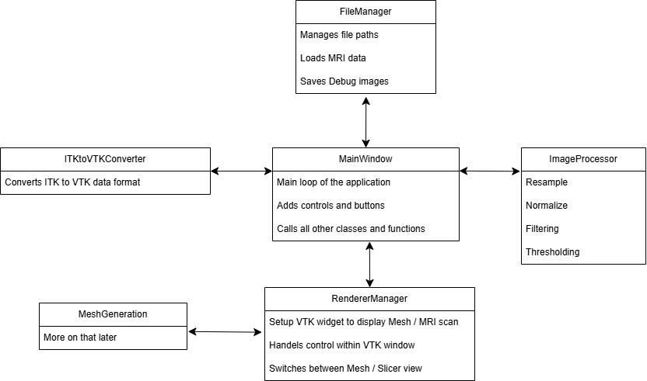
Class interaction overview

Slide 6
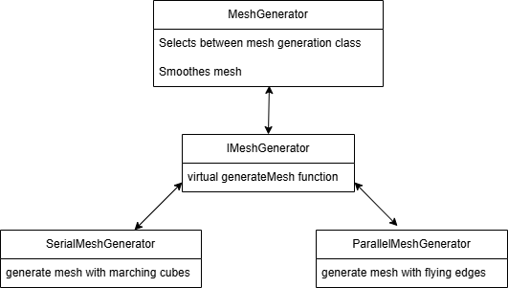
Design pattern and maintainability
Strategy Pattern
Easy exchange of mesh generation algorithm
Uses interface IMeshGenerator to implement same function
Serial and Parallel implement the interface
Sequential : 1.122 sec
Parallel: 0.276 sec

Slide 7

Thank you for your attenetion

